Slide 1



Publishing Open Data
24th Oct 2017
Deirdre Lee
@deirdrelee
@derilinx
www.derilinx.com

Slide 2
What is the level of interest in Open Data?

Slide 3
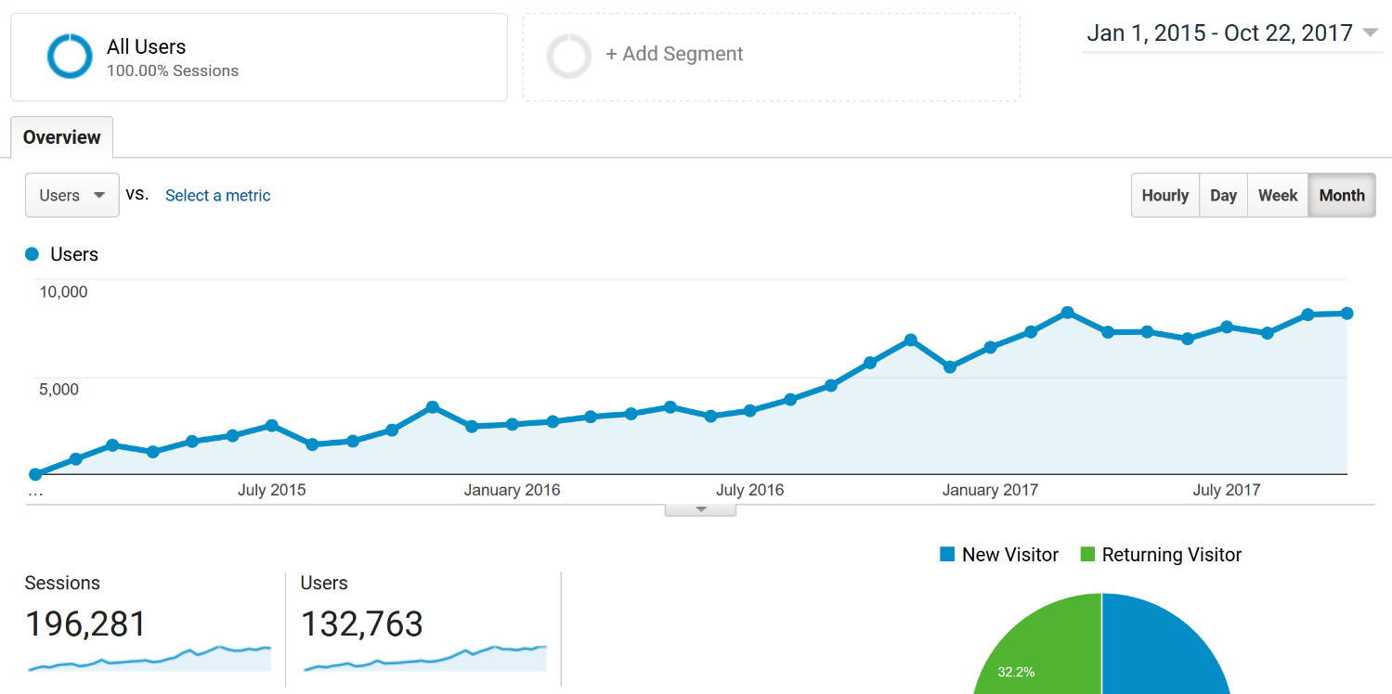

Slide 4

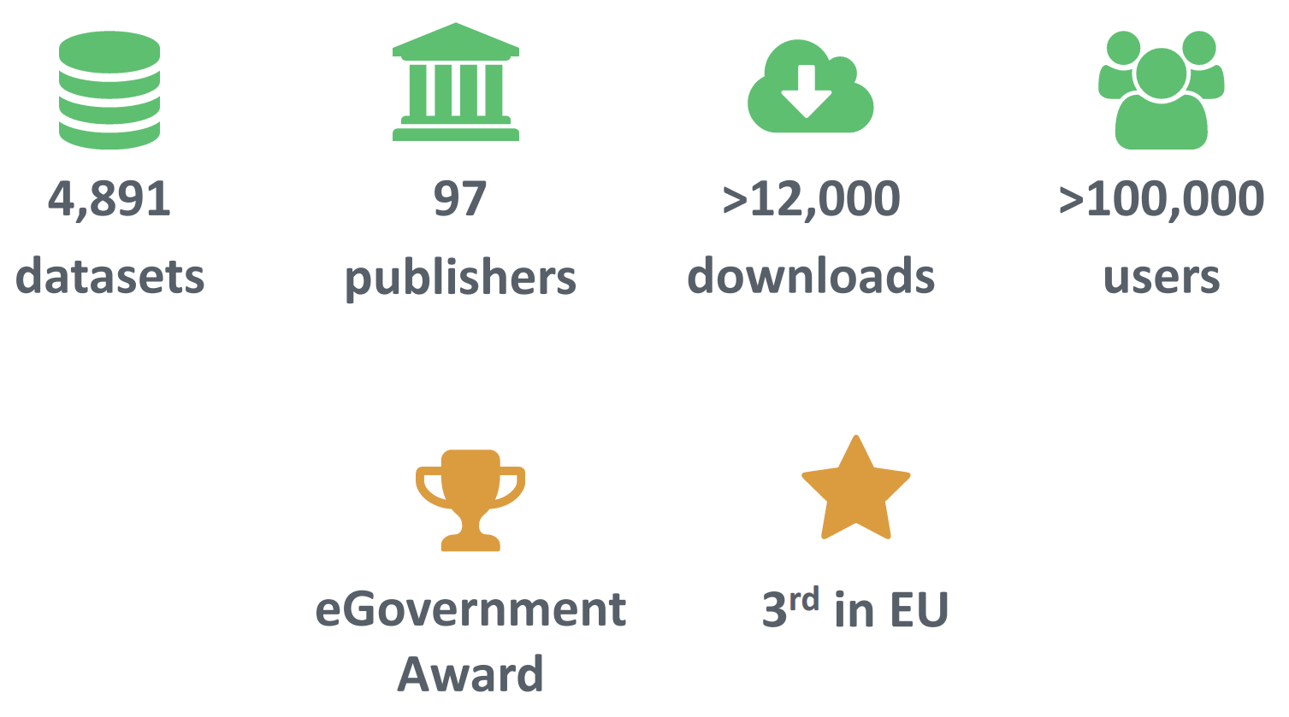
5,509
103
84,556
132,700
>105,000

Slide 5
How is Open Data being used?

Slide 6
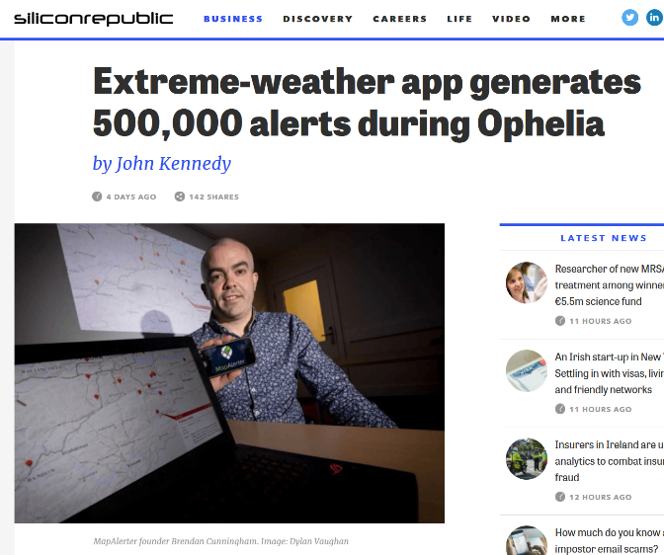
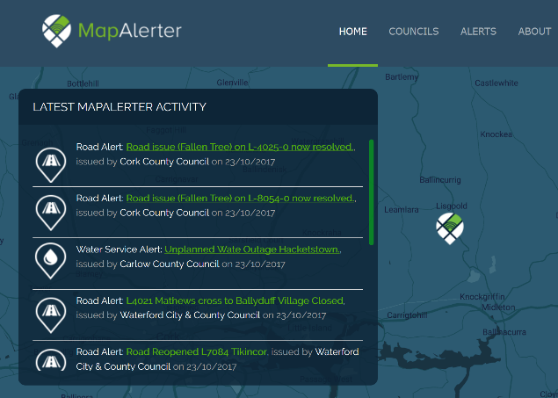
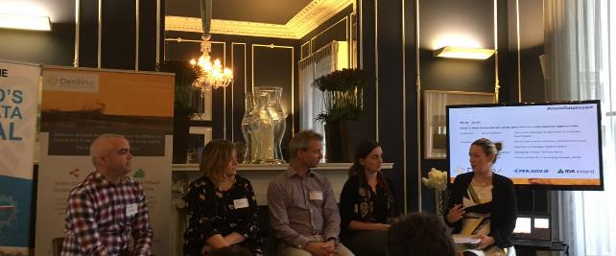
Engagement/Innovation
MapAlerter
https://www.mapalerter.com/

Slide 7
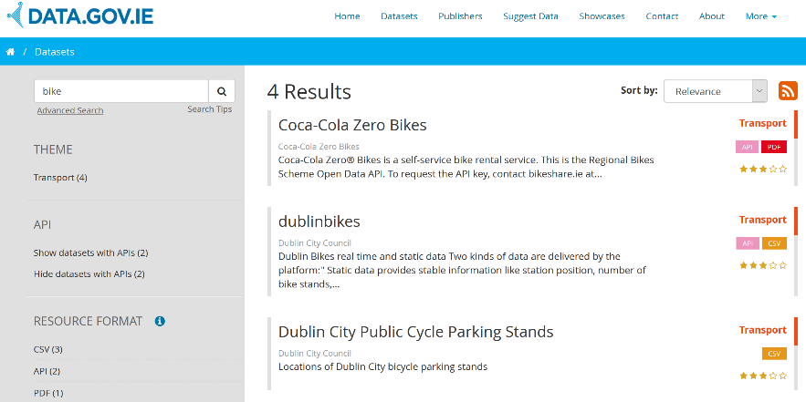
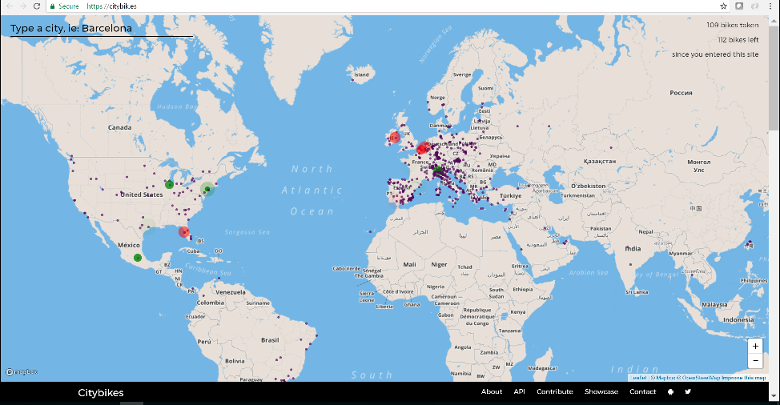
Engagement/Innovation
Citybik
https://citybik.es/

Slide 8
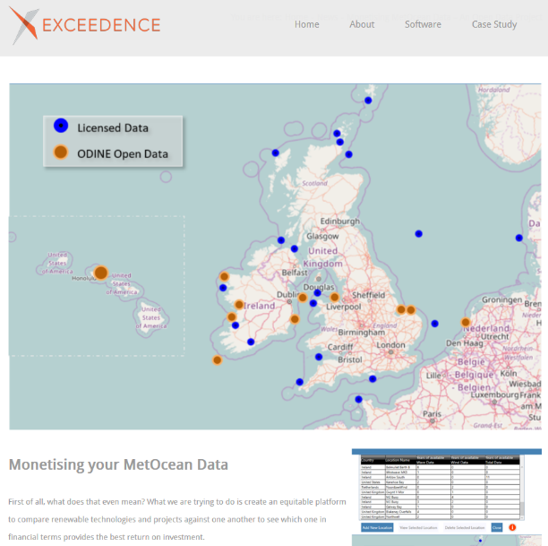
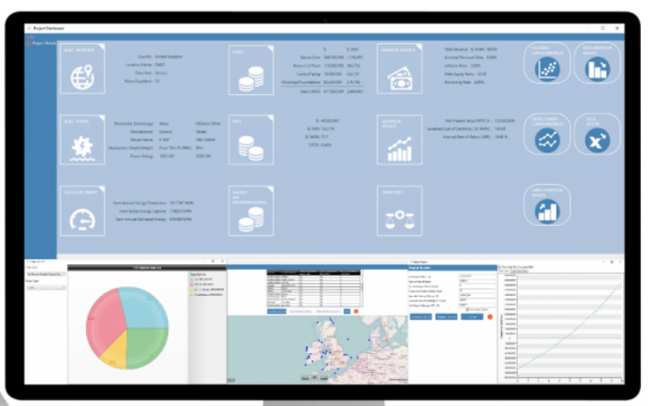
Data Modelling / Decision-Making
Exceedence
http://exceedence.com/monetising-metocean-data-an-open-data-project/
Notes:
to compare renewable technologies to see which provides the best return on investment.

Slide 9
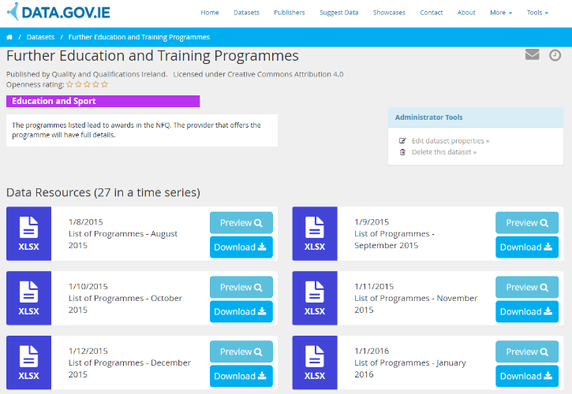
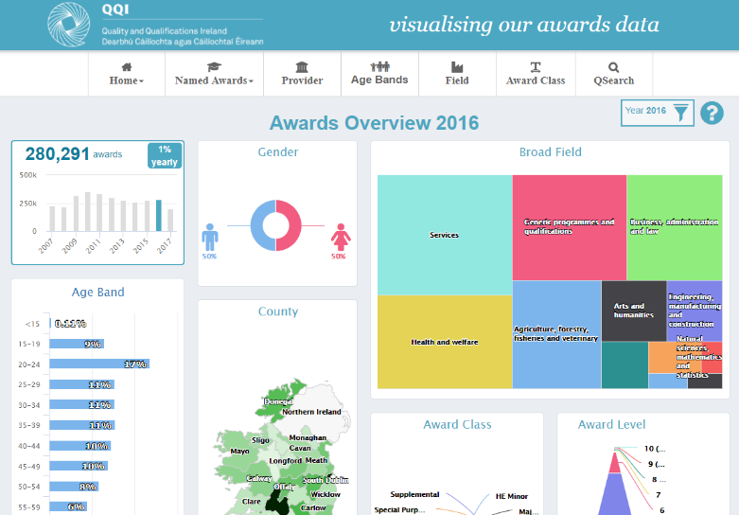
Monitoring / Planning
Quality and Qualifications Ireland
http://infographics.qqi.ie/

Slide 10
Where do I start?

Slide 11
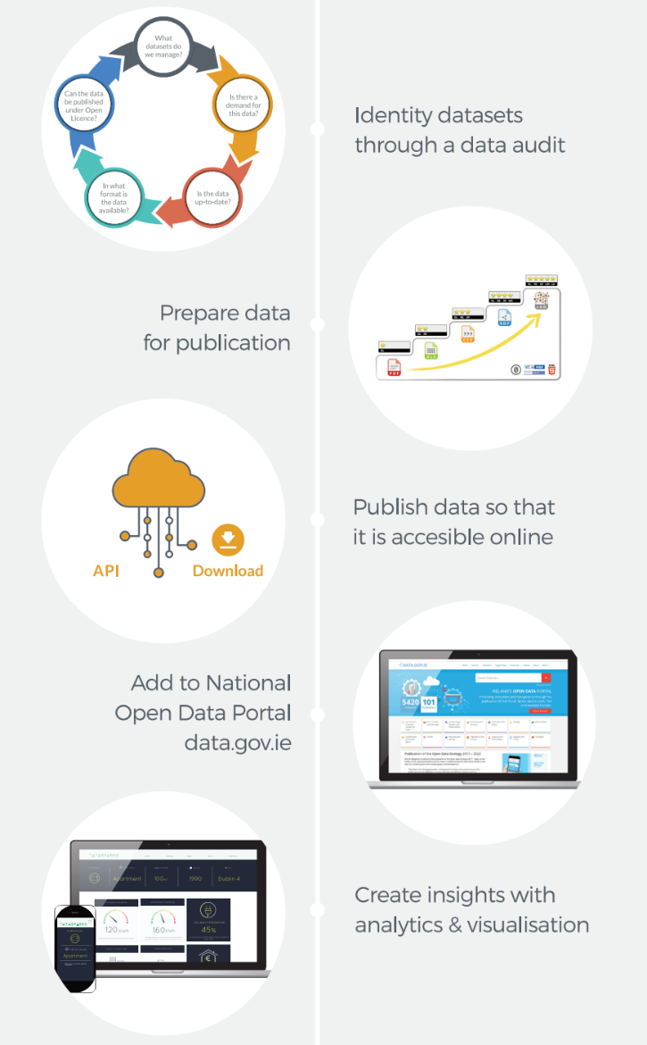

Slide 13
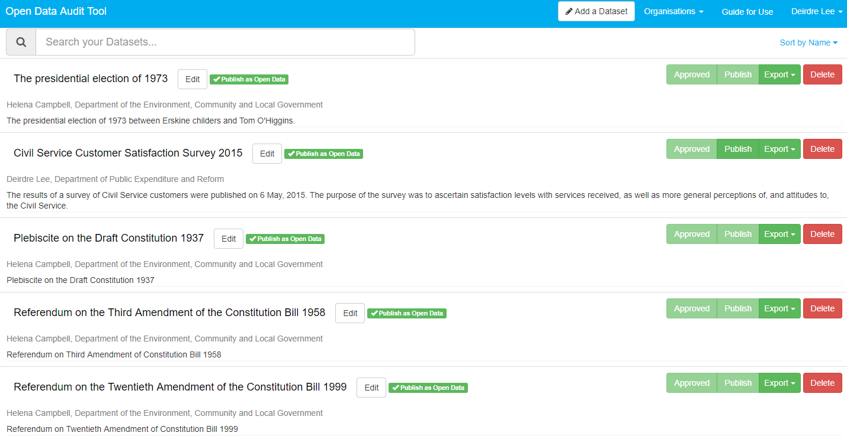
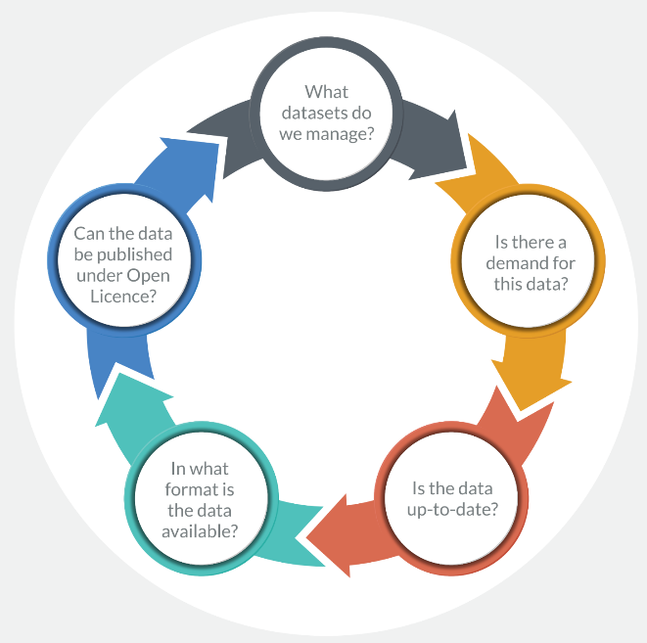
1. Carry out a Data Audit

Slide 14
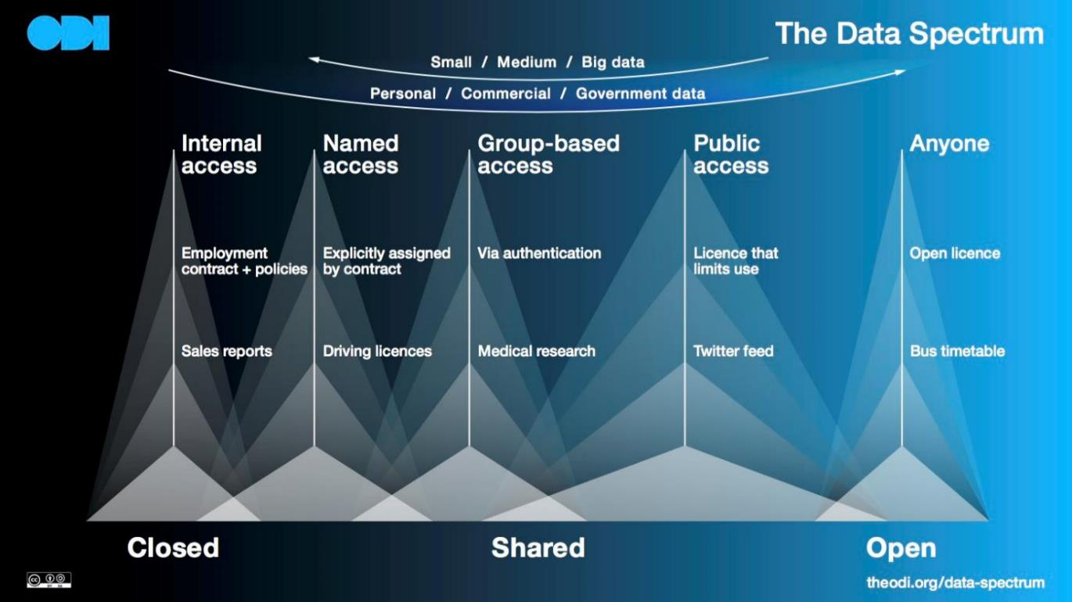
Notes:
The Data Spectrum allows users understand the language of data.

Slide 16
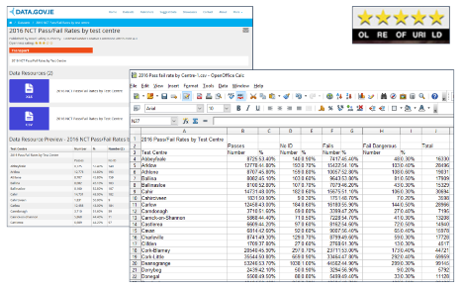
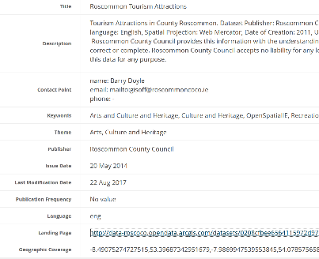
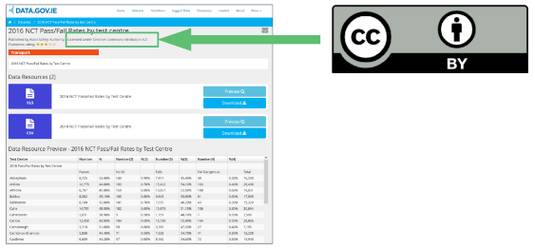
2. Prepare Data for Publication
Machine-readable, open formats
Reusable,
openly licenced
Associate with metadata

Slide 18
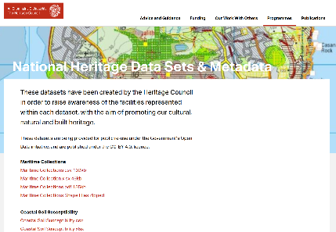
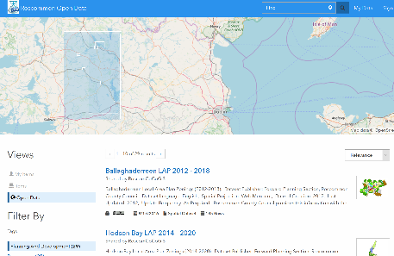
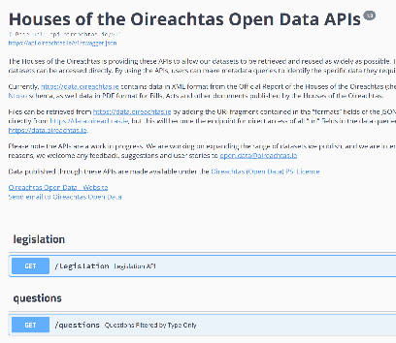
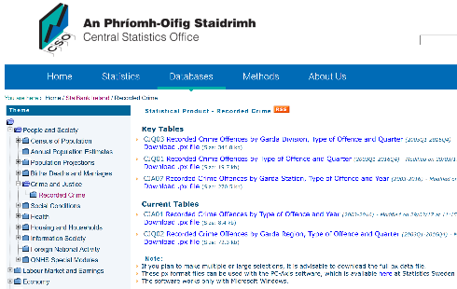
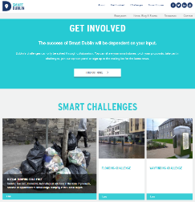

Host your own datasets..
Host datasets on a shared service..

Slide 20
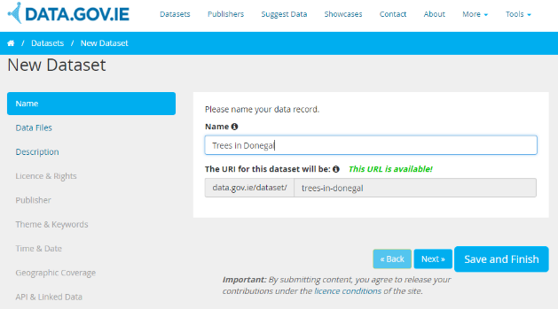
4. Add datasets to data.gov.ie
Manually add metadata to DGI via UI
Programmatically add metadata to DGI via the API (push)
Add metadata via Data Audit Tool
Create harvester to automatically update metadata on DGI (pull)

Slide 21
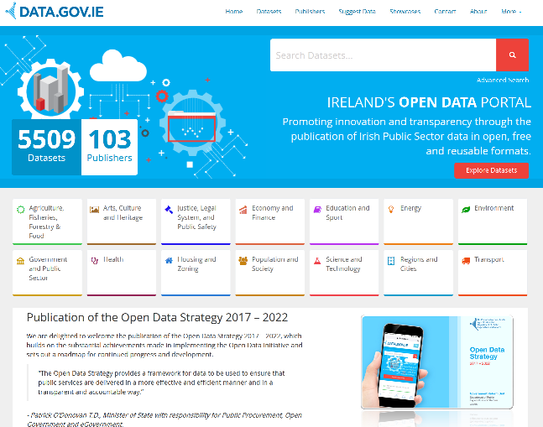
SmartCork
StatBank
Dublinked
StatCentral
Galway CoCo
ISDE
Galway City
OSi
NTA
QQI
eHealth Ireland
Roscommon CoCo

Slide 23
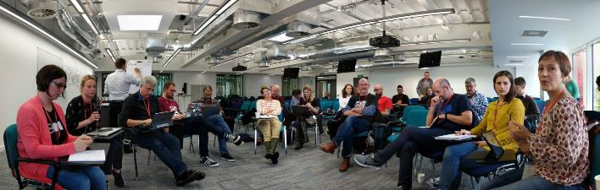
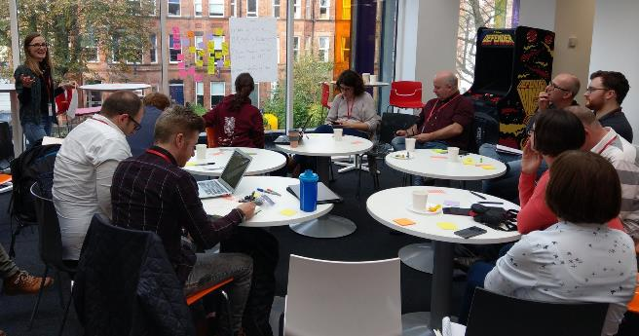

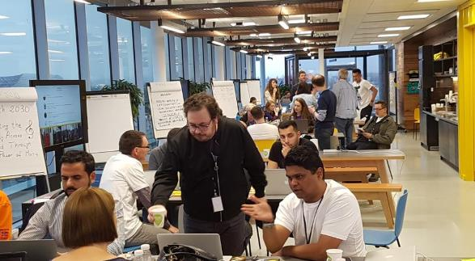
5. Data Use….. (Engage!)
https://twitter.com/search?q=%23odcamp
https://twitter.com/search?q=%23opendataimpact
https://twitter.com/search?q=%23eh2030

Slide 24

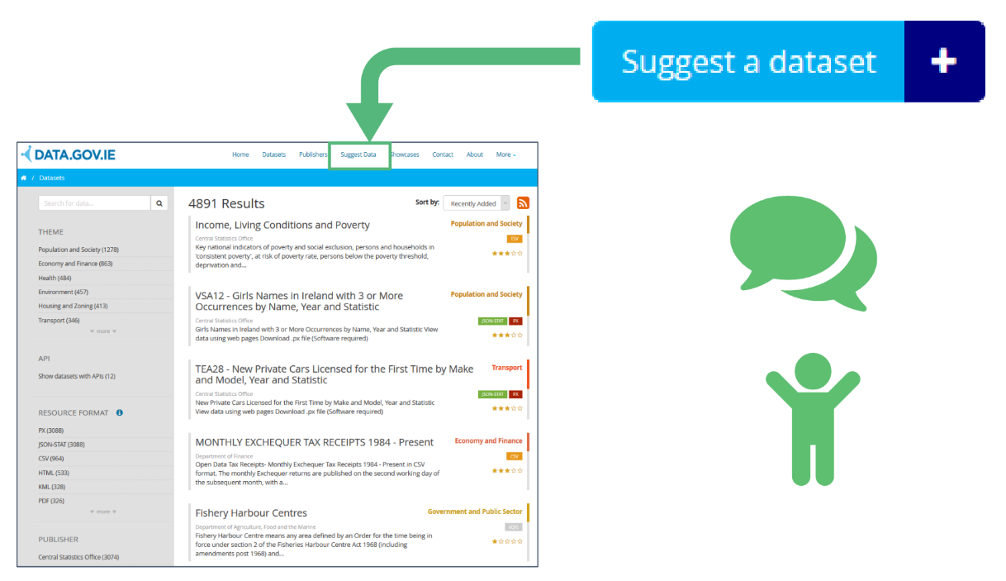
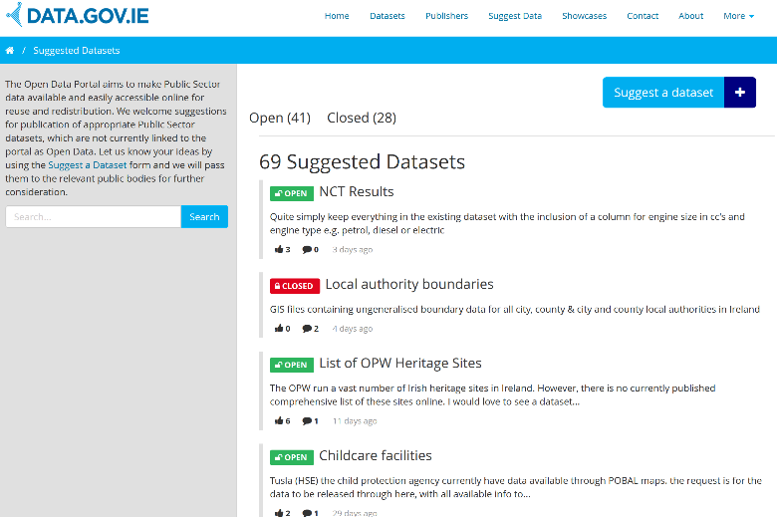

Slide 25
Publishing Open Data
24th Oct 2017
Deirdre Lee
@deirdrelee
@derilinx
www.derilinx.com

